Slide 1
ECON4910/6910: Special topic in Economic Analysis Monetary and financial policies in the wake of the GFC 2023 Edition
Unit Coordinator: Malcolm Edey

Slide 2

About the course (1)
Content
Current issues in monetary and financial policy
Particular emphasis on the role of central banks
Inflation targeting
Financial crises – historical background
The GFC
Central bank policy in the post-GFC world
Impact of Covid-19: recession recovery inflation

Slide 3
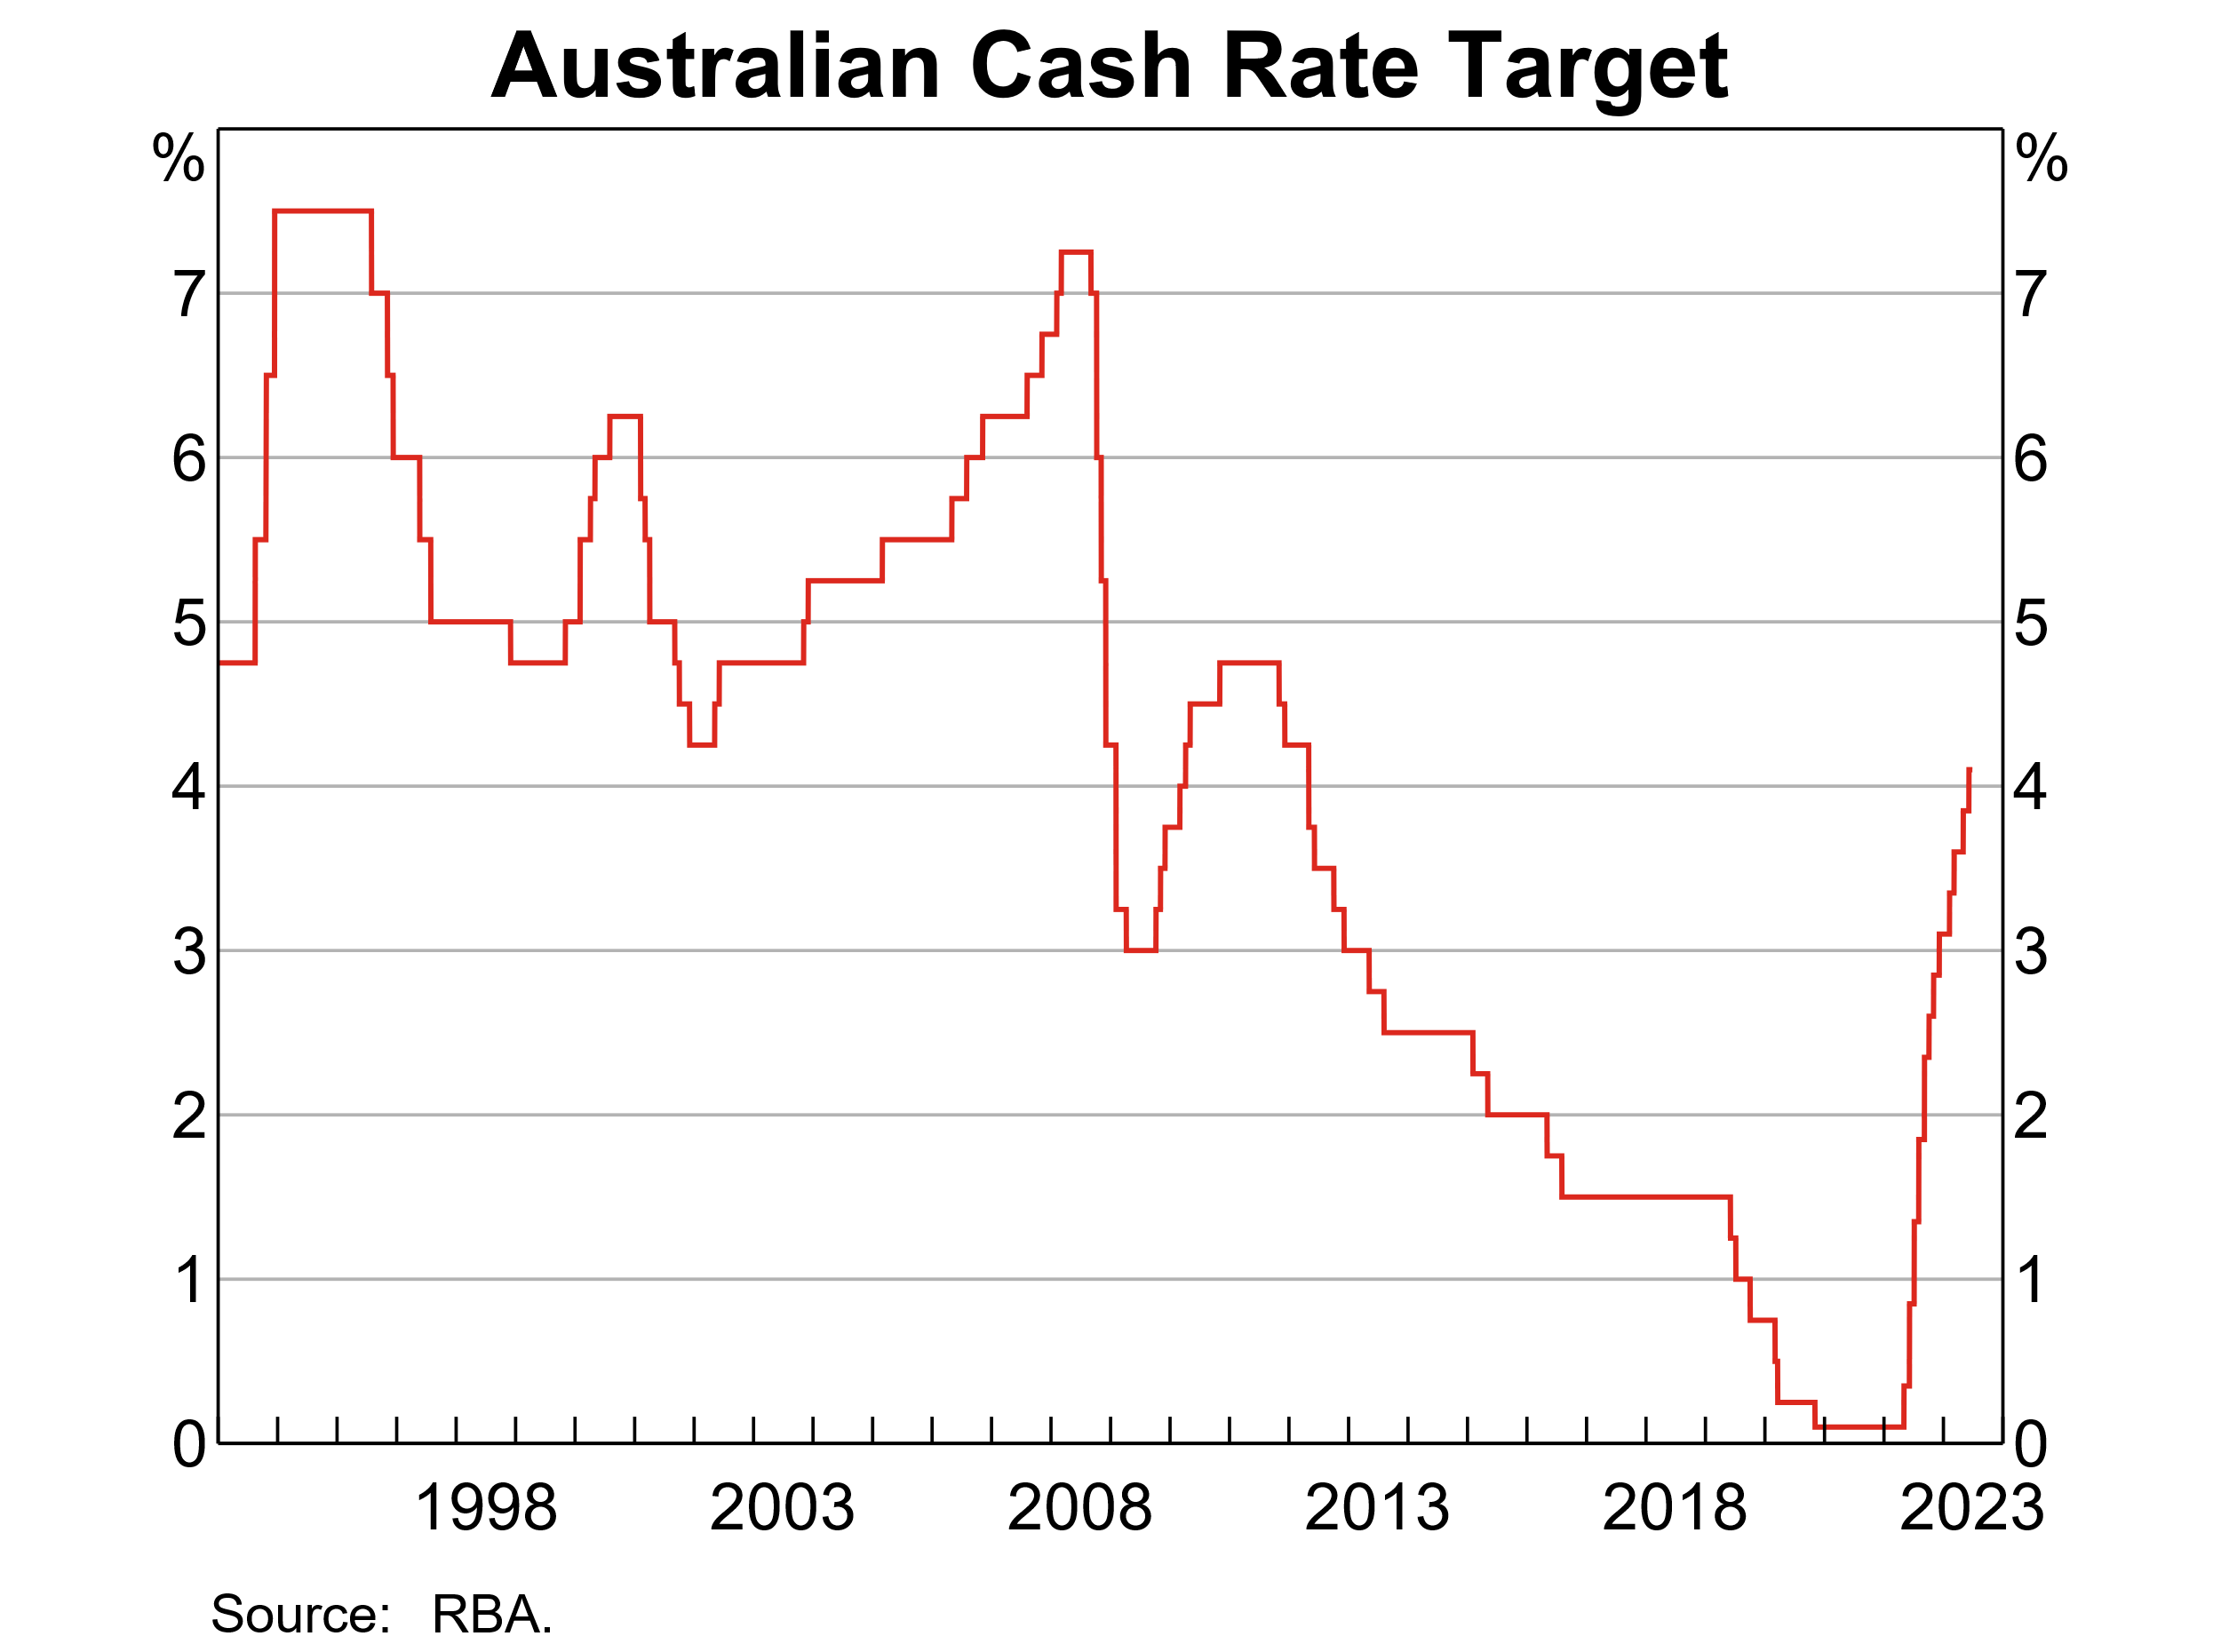

Slide 4
About the course (2)
Learning structure
1 X 3 hour class per week, usually comprising
Either: 2hr lecture + media discussion
Or: Student seminars + media discussion
Not a technical course. It’s mainly about financial history and policy

Slide 5
About the course (3)
Learning objectives
Develop an understanding of:
historical background and rationale for inflation targeting
the current policy environment
what are the unanswered questions
Develop skills in:
interpreting the interplay between new economic data and the policy process
condensing and presenting policy-related information

Slide 6
About the course (4)
Reading and sources
Main reference works (these cover about half the lecture content):
Reinhart and Rogoff (2009)
Bernanke, Geithner and Paulson (2019) on the GFC in the US
Contemporary policy documents, speeches and statements from official sources
A small number of additional journal articles
Normally one recent newspaper article per week (mainly from FT or AFR) – available through the SU library

Slide 7
About the course (5)
Seminars (start week 3)
Each student to present one seminar on an assigned policy document (or part thereof)
Format = 20 min presentation + 5 min Q&A
Media discussions
Please read the assigned media article each week and come prepared to participate in discussion

Slide 8
About the course (5)
Seminar guidelines
Context
Audience
Themes
Comments/criticisms if appropriate
Graphical/tabular material (may be drawn directly from the document)
Explain technical content
Follow up with a written summary (no more than 3 pages)
This component is intended to be similar to a briefing you might be required to give as a professional economist

Slide 9
About the course (6)
Assessment
Seminar presentation + written summary: 20 + 20
Participation: 10
Final exam (covers lecture material + knowledge of current policy environment): 50
exam format is 3 essays, 2hrs

Slide 10
Inflation targeting, part 1 Outline of this week’s lecture
We will learn about the consensus that developed over the period (approx) 1990 – 2010 about how MP should be conducted
Before inflation targets: Friedman’s (1968) summary of the role of monetary policy
The choice of instrument (Macfarlane 2001)
Evolution of the monetary policy framework in Australia (Macfarlane 1998)
Economic rationale and global context (Bernanke and Mishkin)
Operational considerations under uncertainty (Blinder)
Mankiw/Reis (2018) provides a useful synthesis of all this

Slide 11
Real and nominal variables
Nominal: Any variable whose scale (in LR equilibrium) is proportionate to the general price level.
eg the CPI, nominal GDP, the money supply, the dollar price of an individual good or service
Real: Variables whose scale of measurement does not depend on the general price level
eg physical quantities of production, employment, real GDP, relative prices
In practice, real variables are often measured by adjusting a nominal variable for inflation
eg ∆real wage = ∆nominal wage adjusted for CPI movements
In general, it is the real variables that determine economic well-being
But, inflation is generally modelled as having negative utility

Slide 12
Before inflation targeting (1)
Friedman’s (1968) summary of the monetarist position:
Doctrine of monetary neutrality: In the long run, real and nominal magnitudes in the economy are separately determined
hence, in the long run, changing the money supply, or rate of growth of the money supply, has no real effects
The key objectives of macroeconomic policy are real growth, employment and inflation control
Inflation is a nuisance
The central bank controls the money supply, and this anchors the other nominal magnitudes (particularly the price level and hence inflation)

Slide 13
Before inflation targeting (2)
However, monetary policy does have temporary effects on real variables
An expansionary monetary policy (relative to expectations) will cause an acceleration of inflation
This will provide a temporary boost to output and employment, but permanently higher prices or inflation
The effect on output and employment lasts only as long as inflation remains less than fully anticipated (but this may be some time)

Slide 14
Friedman: what monetary policy cannot do
Permanently hold down the level of interest rates
interest rates are a real variable (but related to inflation)
Permanently boost output and employment above levels that would otherwise prevail
“A rising rate of inflation may reduce unemployment, a high rate will not.”

Slide 15
Friedman: what monetary policy can do
Avoid being a source of instability through misguided activism
Impact of ‘long and variable lags’
Control inflation (= Provide the “nominal anchor”)
Analogy of oil and machine
Policy prescription: maintain a steady rate of growth of M consistent with desired inflation rate
Meanwhile, real-economy objectives must be assigned to other policies (eg fiscal, structural)

Slide 16
Evolution of monetary thinking after Friedman The emerging consensus c1990 – c2010
Friedman (1968) was a highly influential summary of the views that came to prevail in central banks in the 70s and 80s
The key strategic propositions from that period continue to guide central bank thinking today
However, that thinking has since been modified in some important ways:
M is not the instrument, R is (but subject to later problem of ZLB)
In extreme conditions, financial stability may become an overriding central bank objective (topic of week 2)

Slide 17
Two views on the choice of instrument
Quantity setting view
(a) CB determines money supply
(b) stable money demand
interaction between (a) (b) and the rest of the economy determines R, output and inflation
Rate setting view
CB determines R, using a policy reaction function
to ensure stability, a nominal anchor must be included in the policy reaction function. Hence, the inflation target
M is endogenous and not relevant to the determination of other variables

Slide 18
Stylised mathematical representation of the two views
Quantity setting
Rate setting
y = f(r, X) (aggregate demand)
y = y* (supply-demand equilibrium)
where y* and X are exogenous
----
Md/p = g(y, r, X) (money demand function)
Md = Ms (monetary equilibrium condition)
Money supply determines the price level
y – y* = f1(r, X) (excess demand is a function of the interest rate)
π = πe + f2(y-y*) (Phillips curve)
r = f3 (y-y*, π–π*) (Policy reaction function)
Inflation is determined by the policy reaction function
Ms adjusts to Md but otherwise irrelevant

Slide 19
Figure 1. Equilibrium in the Market for Money: fixed money supply
Interest Rate, i (%)
M^{s}
A
With excess supply, the interest rate falls to i *.
5
B
4
i * = 3
C
2
D
E
With excess demand,
the interest rate rises
to i *.
1
M^{d}
0
100
200
300
400
500
600
Quantity of Money, M
($ billions)

Slide 20
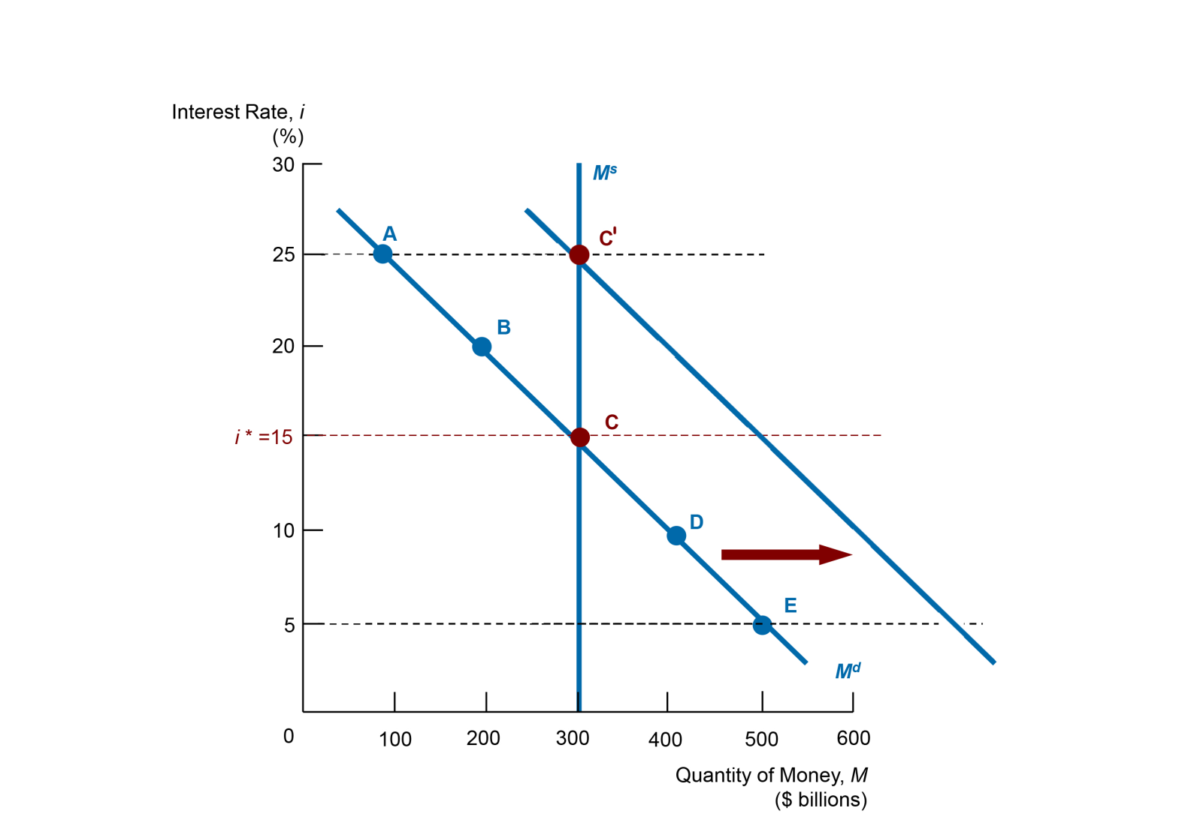

Figure 2. Effect of an increase in money demand when money supply is fixed

Slide 21
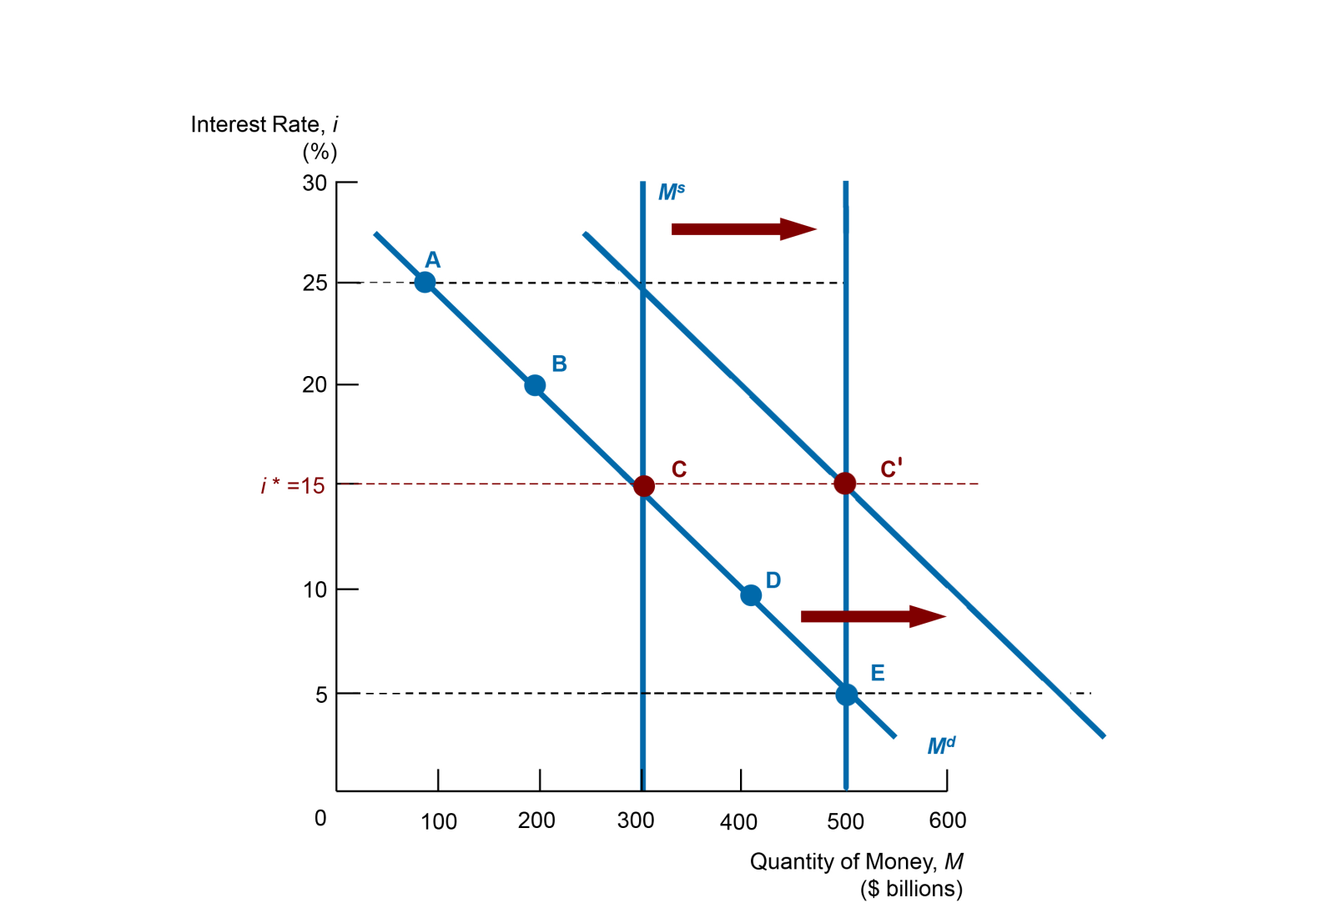
Figure 3. Accommodating an increase in money demand

Slide 22
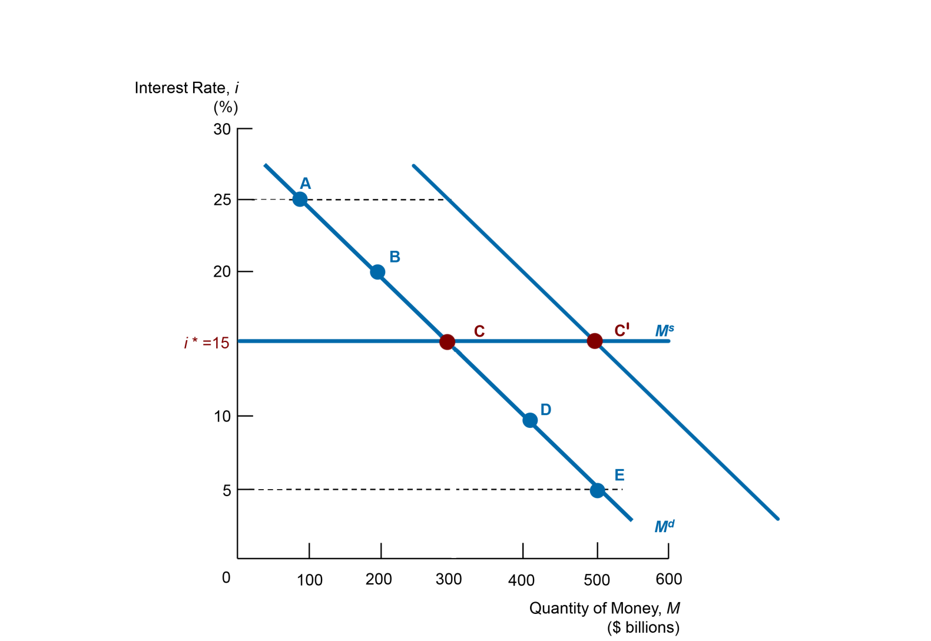

Figure 4. Short-term equilibrium with elastic supply of money

Slide 23
The two views contrasted
Traditional view: quantity-setting – still taught in many textbooks and academic courses
Modern central banking view: rate-setting
All major central banks have adopted the rate-setting view since the early-to-mid 1990s
Central bank policy announcements are now routinely expressed in terms of the policy rate, not the money supply
Most central banks now spend little or no time analysing the monetary aggregates
However, there has been some shift back to focusing on quantities due to ZLB and adoption of QE policies

Slide 24
What does a rate-setting policy look like?
Not a permanently fixed level
The central bank uses R rather than M as the instrument of control
R has to be varied systematically in response to economic conditions
including, crucially, inflation
otherwise there is no nominal anchor (as Friedman recognised)
the inflation target provides the nominal anchor

Slide 25
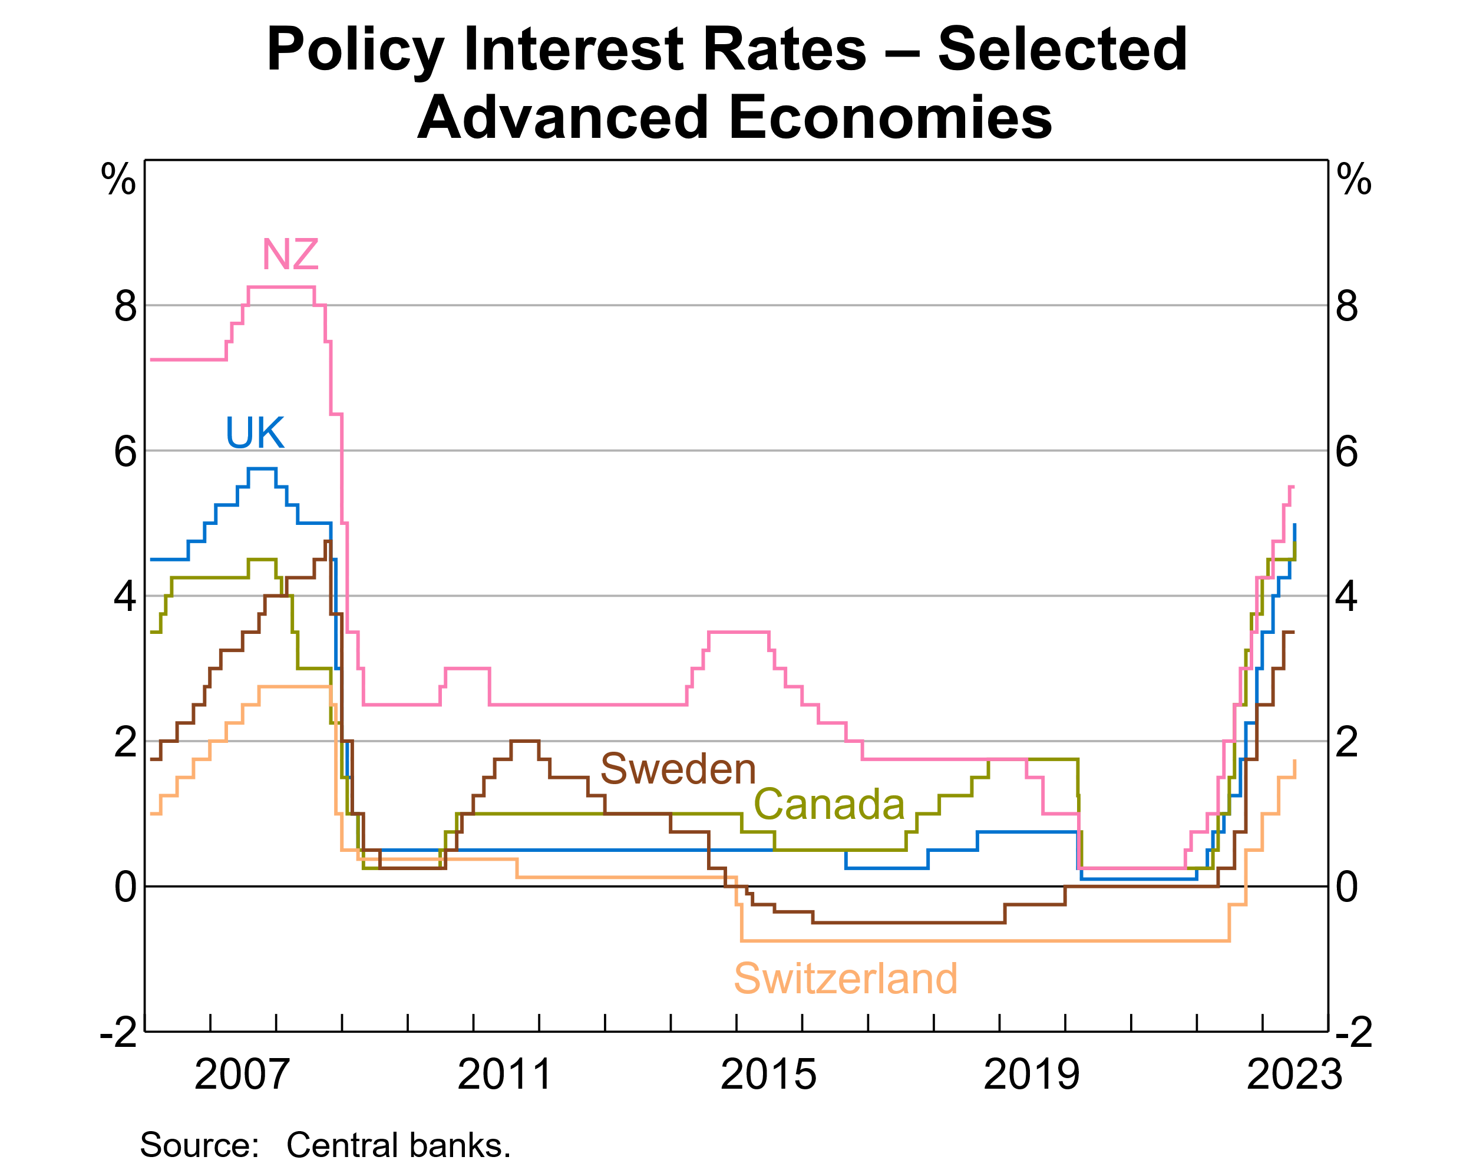
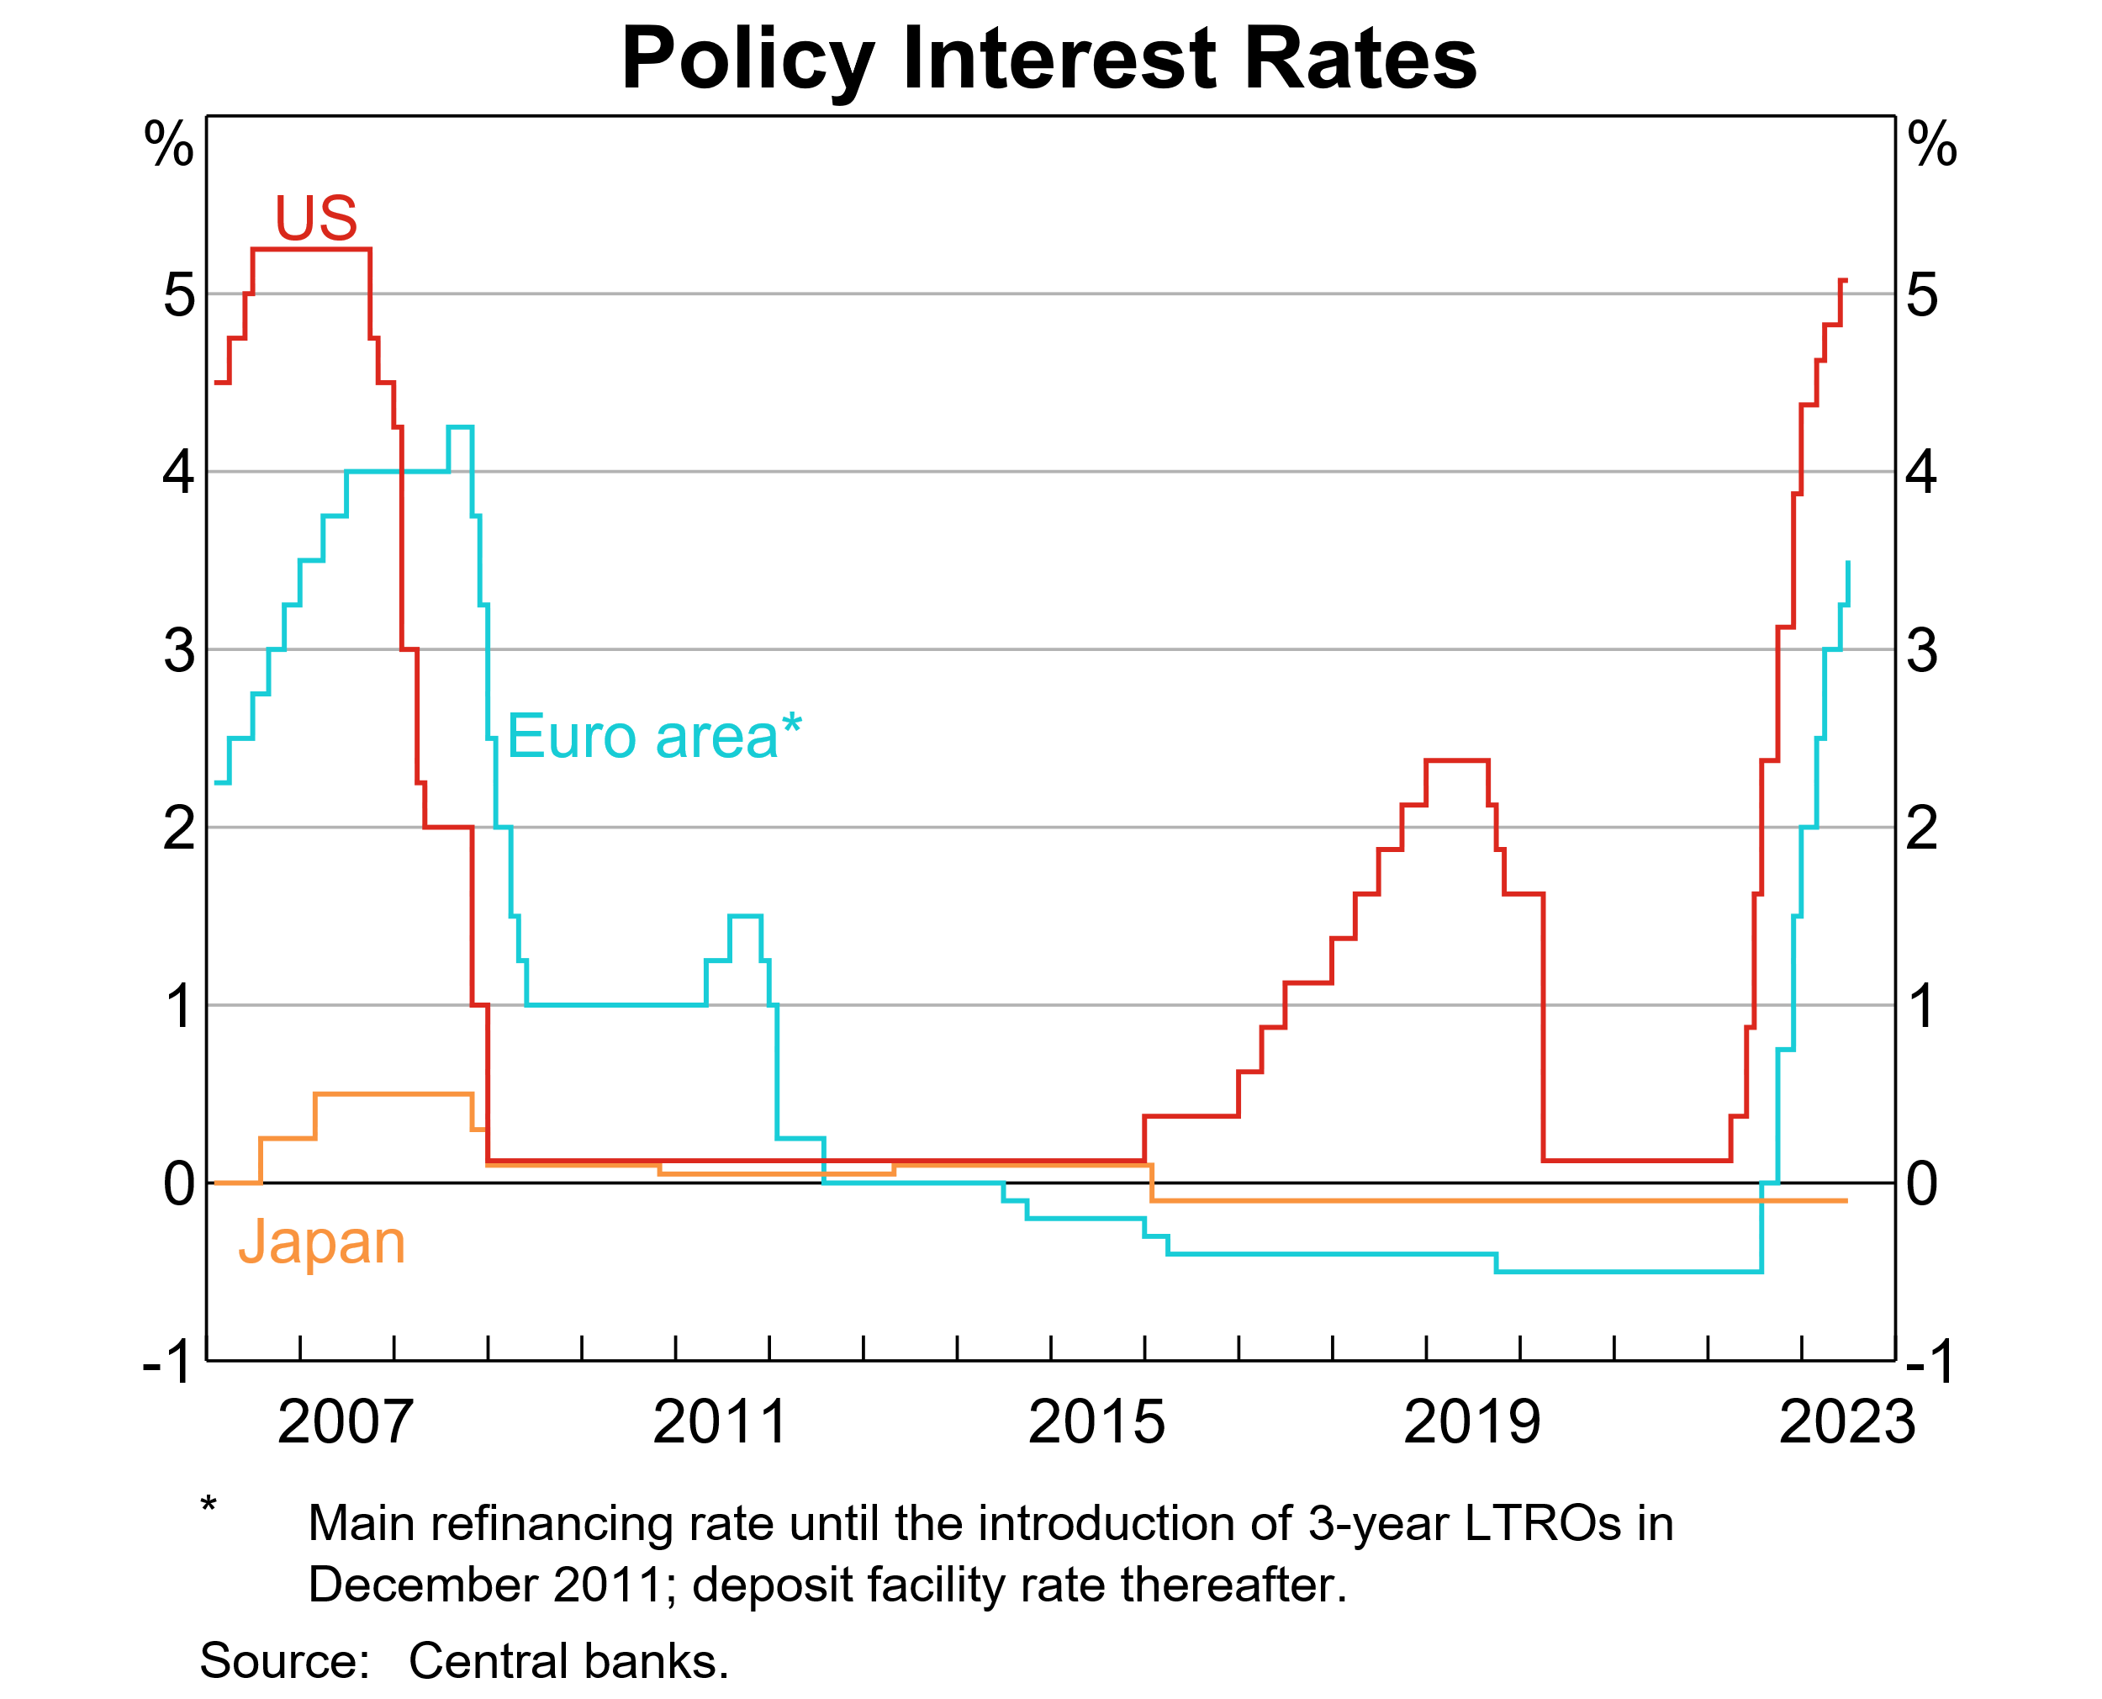

Slide 26
Why has the rate-setting view prevailed?
Unstable demand for money - this would otherwise result in unacceptable volatility of interest rates
The ‘M’ that the central bank can control (money base) is small compared to the ‘M’ that the public uses as money (Broad Money)
The divergence between these two M’s has increased substantially over time, and become more variable (money multiplier unstable)
The monetary aggregates bear little relation to the objectives of monetary policy, which are output and inflation

Slide 27
Why is the quantity-based view still studied?
Still relevant for understanding simpler monetary systems, for monetary history, and for the analysis of hyperinflations
Lingering influence of the monetarist position
Quantities are becoming important again due to ZLB and impact of QE + fiscal deficits
this is a subject of next week’s lecture

Slide 28
Macfarlane (2001): Three questions on the movement of interest rates
If central banks can set the interest rate, why do they have to keep changing it?
Alternatively, why can’t central banks just leave it to the market?
Why do we have to have our own interest rate instead of just adopting the rate from another country like the US?

Slide 29
Question 1: Why is in not feasible to set the interest rate at a fixed level?
Dynamically unstable
Suppose R is set at a rate lower than consistent with general equilibrium: result is an inflationary spiral
Similarly if R is set too high, the result is a deflationary spiral
Even if R is initially exactly right, any random disturbance would be destabilising

Slide 30
Question 2: Why not leave it to the market?
Central bank cannot feasibly cease market operations
Demand for money is unstable
Hence, a quantity setting strategy would result in unacceptable volatility in interest rates

Slide 31
Question 3: why not adopt another country’s interest rate? (small country argument)
This could be achieved as a consequence of a fixed exchange rate
Attempting to do so without a fixed exchange rate would be unstable (for same reasons as Q1)
With a fixed exchange rate, the system would be (essentially) stable, but sub-optimal: domestic monetary conditions would be driven by conditions in another country

Slide 32
Summary: The monetary policy transmission process
Central bank sets the overnight interbank rate
The mechanism for this arises from the CB’s role as monopoly supplier of settlement funds to the banking system
The overnight rate, in turn, influences the rest of the interest rate structure
This in turn influences spending decisions across the economy and hence aggregate macroeconomic conditions
The CB manages the policy rate systematically to achieve policy objectives (the policy reaction function)

Slide 33
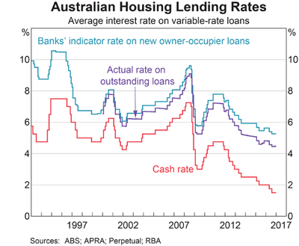
Interest rate transmission

Slide 35
Some history: extracts from selected RBA policy announcements
23 January 1990 (first announcement of an interest rate decision)
The Governor of the Reserve Bank (Mr Bernie Fraser) confirmed that the Bank had operated in the domestic money market this morning to bring about a modest reduction in interest rates.
15 February 1990 (second announcement, note the numerical reference)
The Reserve Bank acted in the domestic money market this morning to bring about a further modest reduction in interest rates. Specifically, the Bank is seeking a reduction in cash rates of up to 0.5 percentage points from their recent levels.

Slide 36
4 April 1990 (third announcement)
The Reserve Bank proposes to operate in the domestic money market this morning with a view to reducing cash rates to within the range of 15 to 15½ per cent. In recent weeks cash rates have averaged a little under 16½ per cent. This action follows yesterday's Board meeting and consultations with the Treasurer.
2 August 1990
The Reserve Bank will be operating in the domestic money market this morning with a view to reducing cash rates by about one percentage point. This action is being taken following the regular late July meeting of the Board and after consultations with the Treasurer.

Slide 37
7 November 2007 (during 2007 election campaign)
At its meeting yesterday, the Board decided to increase the cash rate by 25 basis points to 6.75 per cent.
5 February 2008 (first same-day announcement)
At its meeting today, the Board decided to increase the cash rate by 25 basis points to 7.0 per cent.
1 April 2008 (first no-change announcement)
At its meeting today, the Board decided to leave the cash rate unchanged at 7.25 per cent.

Slide 38
The return of inflation
Two years ago (3 August 2021)
At its meeting today, the Board decided to maintain the cash rate target at 10 basis points and the interest rate on Exchange Settlement balances of zero per cent
The Board will not increase the cash rate until actual inflation is sustainably within the 2 to 3 per cent target range. The central scenario for the economy is that this condition will not be met before 2024.
One year ago (2 August 2022)
At its meeting today, the Board decided to increase the cash rate target by 50 basis points to 1.85 per cent
This week (1 August 2023)
At its meeting today, the Board decided to leave the cash rate target unchanged at 4.10 per cent and the interest rate paid on Exchange Settlement balances unchanged at 4.00 per cent.
Some further tightening of monetary policy may be required to ensure that inflation returns to target in a reasonable timeframe, but that will depend upon the data and the evolving assessment of risks.

Slide 39
What is inflation targeting?
Key elements are:
a measurable numerical target for inflation
a public commitment to achieving it
short-term interest rate is the policy instrument
These things are often accompanied by some formal delegation of authority to the central bank for achieving the target, an accountability mechanism and a set of decision-making procedures (eg RBA Board meetings)

Slide 40
New Zealand as the pioneer inflation targeter
New RBNZ Act came into effect Feb 1990
Part of a wider set of market-based reforms
RBNZ Governor to be the independent decision maker
Policy Targets Agreement with Government set inflation target of 0–2 per cent
Governor could be dismissed for missing the target
Subsequent revisions to the regime have made it less rigid by
raising the target (now 1 – 3 per cent)
‘softening’ the edges

Slide 41
Other early adopters: Canada and UK
Canada adopted an inflation target in Feb 1991
This was by agreement between the Central Bank Governor and the Finance Minister, not by legislation
The target was 1–3 percent, with a transition path (ref Schembri seminar paper)
In the UK, the Bank of England unilaterally adopted a target of 1-4% in Oct 1992 to replace a failed exchange-rate peg (ERM crisis)
May 1997 the BoE was given independence to set the policy rate and an inflation target of 2.5% formally delegated by the government

Slide 42
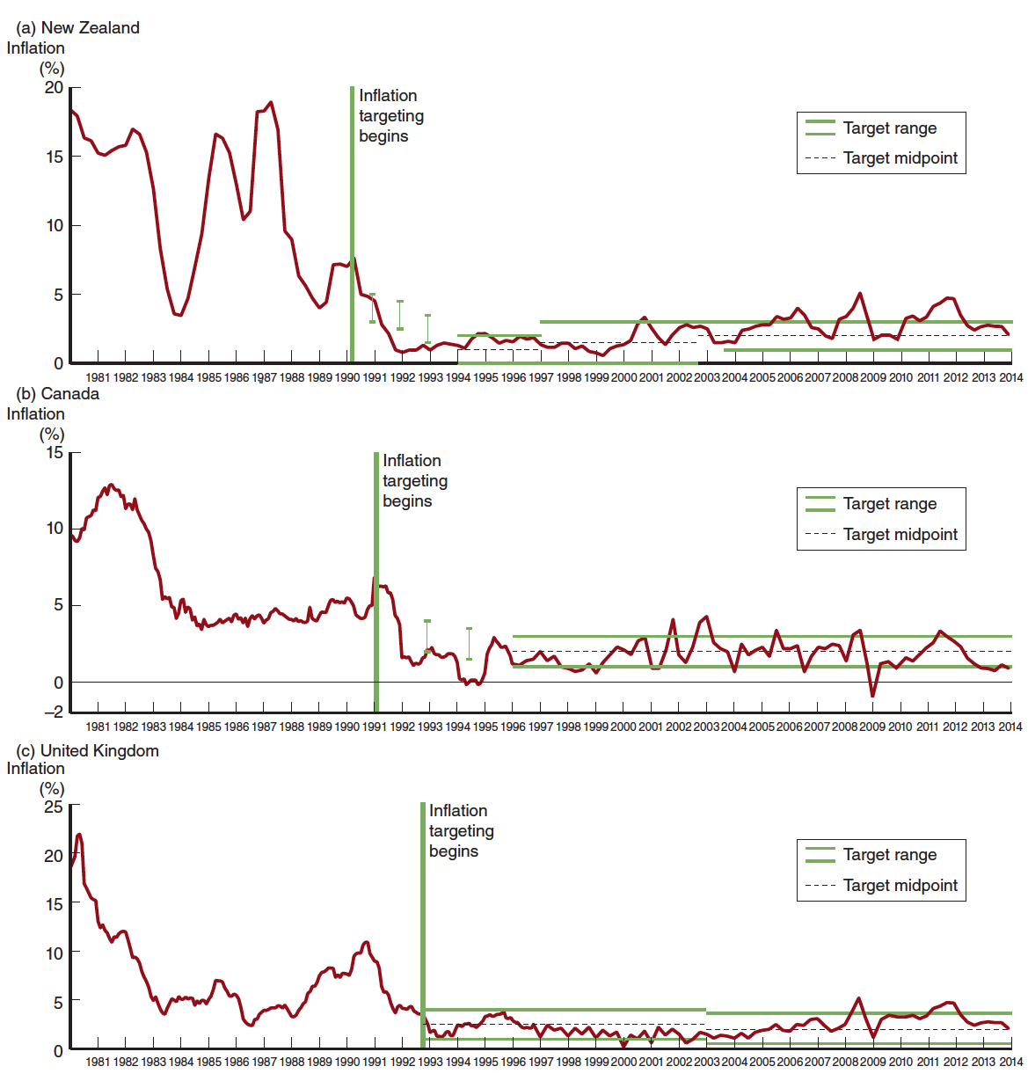
Inflation Rates and Inflation Targets for New Zealand, Canada, and the United Kingdom, 1980–2014

Slide 43
Development of the policy framework in Australia (1)
Source: Macfarlane 1998
In Australia there was no sudden regime change, more a gradual evolution
1945–71: fixed exchange rate
1971-83: gradual increase in exchange rate flexibility
1976-85: monetary targeting (the Friedman influence)

Slide 44
Development of the policy framework in Australia (2)
1983 onwards: floating exchange rate
1985: the ‘checklist’
1988-93: a ‘period of discretion’
1993-96: increased public emphasis on inflation objective
1996: Statement on the Conduct of Monetary Policy (formal adoption of an inflation target of 2-3%)

Slide 45
Macfarlane’s summary of the transition
Analogy with navigating a ship
Stop it leaking = find the instrument that can be controlled
Fix navigation system = find a stable decision making principle
Determine who should be at the helm = find a politically stable set of arrangements for independence and accountability
These things were fully in place by 1996

Slide 46
The RBA Charter (legal basis of the inflation target)
Objectives of Monetary Policy
“The framework for the operation of monetary policy is set out in the Reserve Bank Act 1959 which requires the Board to conduct monetary policy in a way that, in the Board's opinion, will best contribute to the objectives of:
the stability of the currency of Australia;
the maintenance of full employment in Australia; and
the economic prosperity and welfare of the people of Australia.
The first two objectives lead to the third, and ultimate, objective of monetary policy and indeed economic policy as a whole. These objectives allow the Reserve Bank to focus on price (currency) stability while taking account of the implications of monetary policy for activity and, therefore, employment in the short term. Price stability is a crucial precondition for sustained growth in economic activity and employment.”
Source: Statement on the Conduct of Monetary Policy

Slide 47
Statement on the Conduct of Monetary Policy 1996
“In pursuing the goal of medium term price stability the Reserve Bank has adopted the objective of keeping underlying inflation between 2 and 3 per cent, on average, over the cycle. This formulation allows for the natural short run variation in underlying inflation over the cycle while preserving a clearly identifiable benchmark performance over time.”
Points to note:
numerical objective (2-3 per cent)
on average
underlying = abstracting from temporary or idiosyncratic factors
no new legislation, but an agreed interpretation of existing law

